Slide 1
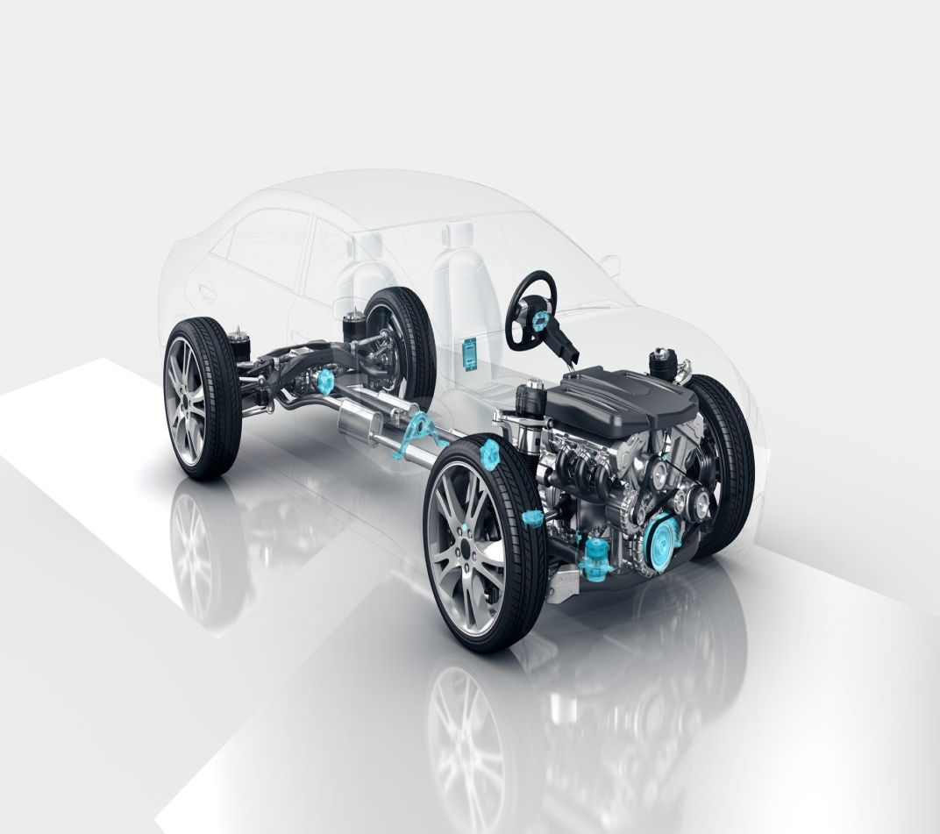

Automotive Electronics Group
School of ECE
Senior Design Project
Review-4
Team No: 08
Students Details:
1. Soumya D USN: 01FE18BEC181
2. Veena Kabadi USN: 01FE18BEC202
3. Ameena Khadri USN: 01FE18BEC217
4. Somashekar Swamy USN: 01FE18BEC225
Guide Details:
Prof. Prabha N

Slide 2
Automotive Electronics Group
School of ECE
Contents
Introduction
Need Statement
Literature Survey
Problem Statement
Objectives
Functional Block Diagram
Project Planning : Tasks
Project Planning : Gantt Chart
Project Planning : Work Breakdown Structure

Slide 3
INTRODUCTION
Automotive Electronics Group
School of ECE
A self-driving car also known as an autonomous vehicle, is a vehicle that is capable of sensing its environment and which operates without human involvement.
Detection and Tracking of objects is one of the important features of Autonomous Vehicles.
Multiple object tracking (MOT) relies on detecting and identifying targets within images or videos.
The main goal of multi object tracking is to follow paths or trajectories of multiple targets in a sequence.

Slide 4
NEED STATEMENT
Automotive Electronics Group
School of ECE
“Multi Object Tracking for Autonomous Vehicles”
Object tracking is an algorithm that tracks the displacement of several objects.
Tracking plays an important role in obstacle avoidance, path planning and has numerous applications in traffic control.
In computer vision, object detection is scanning and searching for an object in an image or a video. Whereas, object tracking is like spying on someone and following it.
Developing an effective and accurate visual tracking system is very challenging due to number of problems such as Illumination variation, the overlap between objects etc.

Slide 5
LITERATURE SURVEY
Automotive Electronics Group
School of ECE
Paper 1: Object Tracking using Improved Deep Sort YOLOV3 Architecture
(Tuan Linh Dang, Gia Tuyen Nguyen and Thang Cao)
In this paper, the input video is divided and processed frame by frame using YOLO, DeepSORT, and Dlib components.
To get the information regarding the bounding box, the class and the features of object is processed using the YOLO detection.
The goal of the tracking is to assign the detected bounding boxes with the object IDs already appearing in the previous frame
The Deep Sort process, tracks the detected object using the location metric (IoU) and appearance metric(feature) and assigns object ID to the detected bounding box.
The unassigned bounding boxes are sent to the Dlib process through a queue called “new object ID”.

Slide 6
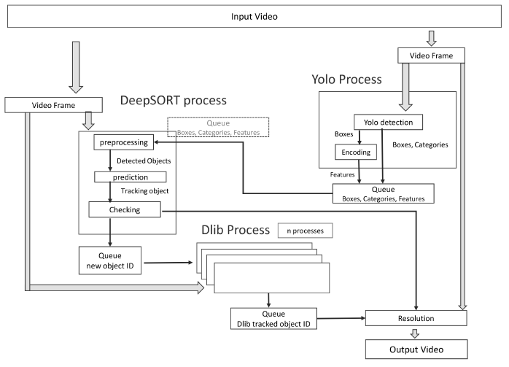
Automotive Electronics Group
School of ECE
If feature metric is used, the bounding box from DeepSORT is used for the objectID
If IoU metric is used, a new IoU of bounding box tracked by DeepSORT and the bounding box tracked by Dlib is calculated

Slide 7
Automotive Electronics Group
School of ECE
Paper 2: Dynamic Object Tracking for Self-Driving Cars Using Monocular Camera and LIDAR
(Lin Zhao, Meiling Wang, Sheng Su, Tong Liu, and Yi Yang)
In this paper, tracking system is based on the combination of a monocular camera and a LIDAR sensor proposed to track specified targets in actual traffic scenes.
The tracking system consists of three modules: mask generation, depth estimation, and re-tracking mechanism.
Mask generation: ROI(region of interest) is selected where the desired object is present which is represented using bounding box.
Depth estimation: The generated mask provides pixel-level information for the depth estimation module,Spatial positions are estimated.
Re-tracking mechanisms: if the tracked object goes out of track it can be restored.

Slide 8
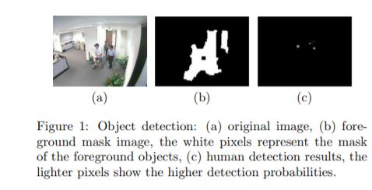
Automotive Electronics Group
School of ECE
Paper 3: A Detection-Based Multiple Object Tracking Method
(Mei Han Amit Sethi Yihong Gong)
In this paper a method for tracking multiple objects whose number is unknown and varies during tracking is described.
The multiple object tracking method works on fixed cameras.
Each hypothesis consists of the number of objects and their trajectories.
The first step in tracking is to extend the graph to include the most recent object detection results, that is, to generate multiple hypotheses about the trajectories.

Slide 9
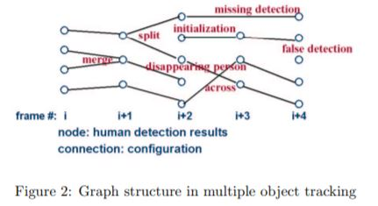
Automotive Electronics Group
School of ECE
In the graph structure , the graph nodes represent the object detection results.
Each node is composed of the object detection probability, object size or scale, location and appearance.
Each link in the graph is computed based on position closeness, size similarity and appearance similarity between two nodes (detected objects).

Slide 10
PROBLEM STATEMENT “Multi – Object tracking for Autonomous Vehicles using Deep Sort Algorithm”
Automotive Electronics Group
School of ECE
OBJECTIVES
To locate all object instances belonging to one or more specified object classes, regardless of scale, position, pose, camera view, partial occlusions, or lighting conditions.
To obtain the mathematical model description of Deep Sort Algorithm.
To learn extraction of features from the image using base network Kalman filter and Hungarian algorithm .
To verify and validate the model for different real-time test conditions.
To calculate the algorithm's performance based on many performance metrics.

Slide 11
Automotive Electronics Group
School of ECE
Why do we need Tracking?
1.To model object when detection fails :
Occlusions
Viewpoint/pose/blur/illumination variation (in few frames of sequence)
Background clutter
2. To reason about dynamic world ,e.g. trajectory prediction (is Person is going to cross the street ?)

Slide 12
Automotive Electronics Group
School of ECE
Different Type of Tracking:-
1.Point Object Tracking
At most one detection per object ,per time .
2.Group Object Tracking
Several object treated as single ,a group possible more than one detection per group, per time step.
3.Tracking with Multipath
Possible more than detection per object ,per time

Slide 13
Automotive Electronics Group
School of ECE
MULTIPLE OBJECT DETECTION
Yolo V4
YOLOv4 is an object detection algorithm that is an evolution of the YOLOv3 model.
MULTIPLE OBJECT TRACKING
Deep Sort Algorithm
Kalman Filtering to process the correlation of frame-by-frame data
Hungarian algorithm for correlation measurement
CNN Network for training and feature

Slide 14
FUNCTIONAL BLOCK DIAGRAM
Automotive Electronics Group
School of ECE
Object
Detection
Train
IInput Video Sequence
YOLOv4
Detection
Object
Tracking
Kalman Predict
Hungarian
Algorithm
CNN
Extraction

Slide 15
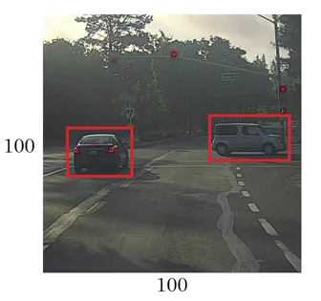
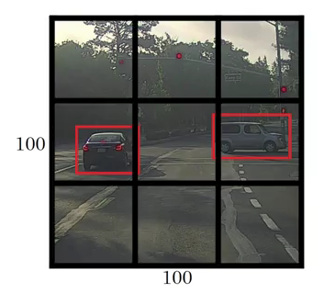
Mathematical Model
Automotive Electronics Group
School of ECE
YOLOV4
YOLO first takes an input image:
The framework then divides the input image into grids (say a 3 X 3 grid):

Slide 16
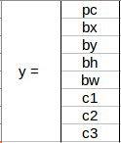

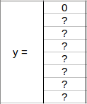
Mathematical Model
Automotive Electronics Group
School of ECE
Image classification and localization are applied on each grid. YOLO then predicts the bounding boxes and their corresponding class probabilities for objects .
p_{c} defines whether an object is present in the grid or not (it is the probability)
b_{x}, b_{y}, b_{h}, b_{w} specify the bounding box if there is an object
c₁, c₂, c₃ represent the classes. So, if the object is a car, c₂ will be 1 and c_{1 &} c₃ will be 0, and so on
we select the first grid from the above example:1
Since there is no object in this grid, pc will be zero and the y label for this grid will be:

Slide 17

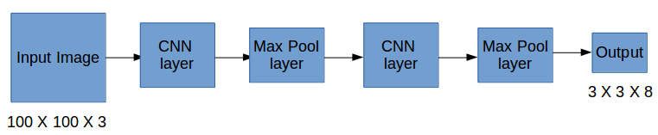
Automotive Electronics Group
School of ECE
Let’s take another grid in which we have a car (c₂ = 1):
Since there is an object in this grid, p_{c} will be equal to 1
b_{x}, b_{y}, b_{h}, b_{w} will be calculated relative to the grid cell we are dealing with.
Since car is the second class, c₂ = 1 and c₁ and c₃ = 0.So, for each of the 9 grids, we will have an eight-dimensional output vector. This output will have a shape of 3 X 3 X 8
Input image – 100 X 100 X 3, output – 3 X 3 X 8, our model will be trained as follows:

Slide 18
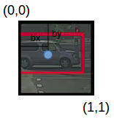
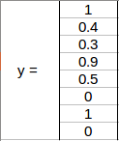
Automotive Electronics Group
School of ECE
b_{x}, b_{y} are the x and y coordinates of the midpoint of the object with respect to this grid.
In this case, it will be b_{x} = 0.4 and b_{y} = 0.3
b_{h} is the ratio of the height of the bounding box
b_{h} = 0.9
b_{w} is the ratio of the width of the bounding box to the width of the grid cell
b_{w} = 0.5

Slide 19
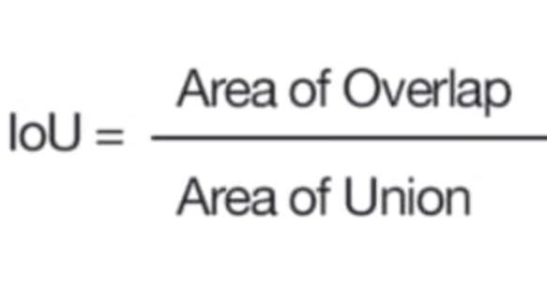
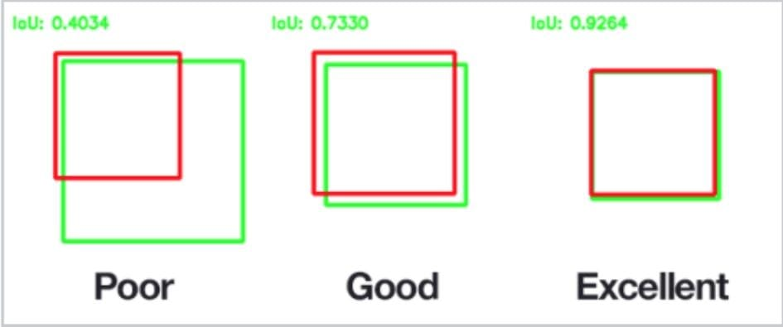
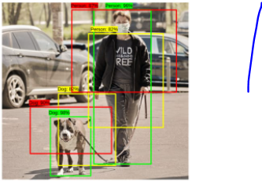
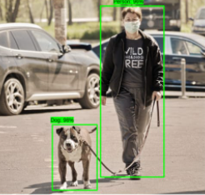
Automotive Electronics Group
School of ECE
Matching strategy
During training we need to determine which default boxes correspond to a ground truth detection and train the network accordingly. For each ground truth box, we are selecting from default boxes that vary over location, aspect ratio, and scale. We begin by matching each ground truth box to the default box with the best Jaccard overlap .
Non Max Suppression:
NMS
BEFORE

Slide 20
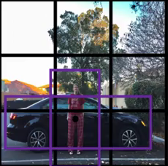
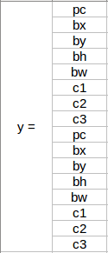
Automotive Electronics Group
School of ECE
Anchor Boxes:-
Consider the following image, divided into a 3 X 3 grid:
The first 8 rows belong to anchor box 1 and the remaining 8 belongs to anchor box 2.
The output in this case, instead of 3 X 3 X 8 (using a 3 X 3 grid and 3 classes), will be 3 X 3 X 16 (since we are using 2 anchors).

Slide 21

Automotive Electronics Group
School of ECE
Deep Sort-Kalman filter algorithm
Data Input
Original Error Estimate
Original Estimate
Error in
Estimate
Error in Data
Previous Estimate
Measured Value
1.Calculate the Kalman Gain
2.Calculate Current Estimate
3.Calculate new Error
Updates Estimate

Slide 22
Mathematical model:
Automotive Electronics Group
School of ECE
Kalman gain=kg
Error in estimate=Eest
Error in measurement=Emea
Kg=Eest/Eest+Emea
0<=Kg<=1
Current estimate=ESTt
Previous estimate=ESTt-1
ESTt=ESTt-1+Kg[MEA-ESTt-1]
Where MEA=measurement
Calculate new Error
Eest(t)=[1-KG] Eest(t-1)
Error in Data(MEASURMENT)
Error in
Estimate
Calculate the Kalman Gain

Slide 23
Hungarian Algorithm
Automotive Electronics Group
School of ECE
 | Tracking 1 | Tracking 2 | Tracking 3
Object A | 10 | 15 | 9
Object B | 9 | 18 | 5
Object C | 6 | 14 | 3
Step 1 — Subtract the minimum from each row
Remove minimum from the row
 | Tracking 1 | Tracking 2 | Tracking 3
Object A | 1 | 6 | 0
Object B | 4 | 13 | 0
Object C | 3 | 11 | 0

Slide 24
Step 2 — Subtract the minimum from each column
Automotive Electronics Group
School of ECE
 | Tracking 1 | Tracking 2 | Tracking 3
Object A | 0 | 0 | 0
Object B | 3 | 7 | 0
Object C | 2 | 5 | 0
Step 3 — Cross 0s with the minimum number of lines, then check the number of lines needed.
 | Tracking 1 | Tracking 2 | Tracking 3
Object A | 0 | 0 | 0
Object B | 3 | 7 | 0
Object C | 2 | 5 | 0

Slide 25
Step 4 —Subtract the Smallest Element of the Entire Matrix. If an element has been crossed twice, add it to the place where it’s double crossed.
Automotive Electronics Group
School of ECE
 | Tracking 1 | Tracking 2 | Tracking 3
Object A | 0 | 0 | 2
Object B | 1 | 5 | 0
Object C | 0 | 3 | 0
Step 5 — Assign Tracking and Objects starting with the line with only one zero,Every time we assign a Tracking and Objects, cross its row and column to make it unavailable.
 | Tracking 1 | Tracking 2 | Tracking 3
Object A | 0 | 0 | 2
Object B | 1 | 5 | 0
Object C | 0 | 3 | 0

Slide 26
Automotive Electronics Group
School of ECE
Now, we have an optimal assignment
Tracking 1
Tracking 2
Tracking 3
Tracking 1
Tracking 2
Tracking
 | Tracking 1 | Tracking 2 | Tracking 3
Object A | 10 | 15 | 9
Object B | 9 | 18 | 5
Object C | 6 | 14 | 3
Tracking 1 | Object C
Tracking 2 | Object A
Tracking 3 | Object B

Slide 27
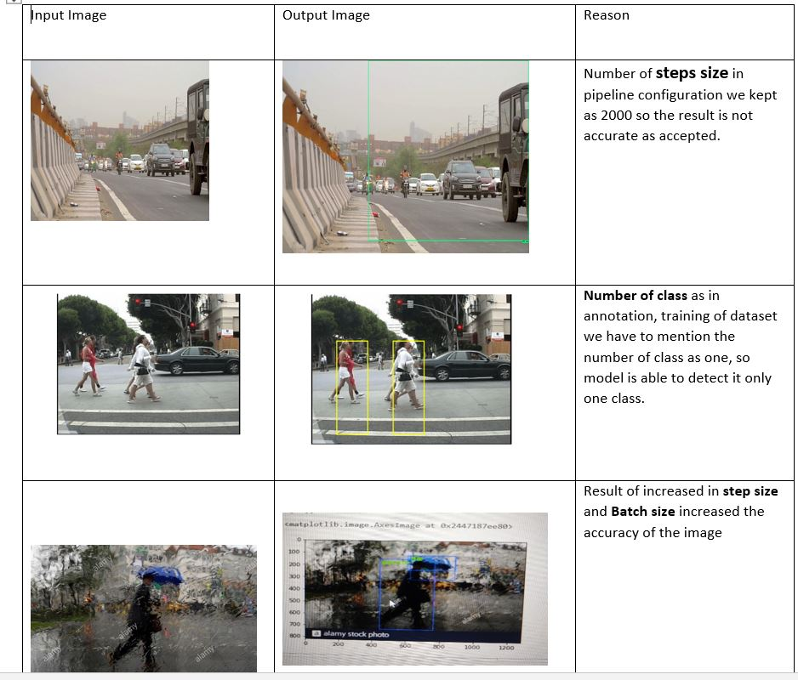

Slide 28
Automotive Electronics Group
School of ECE
Project Planning:Tasks from August to December
Task No. | Task | Objectives mapping to tasks
1 | Understanding and Converting the Need Statement to Problem Statement | Objective 1
2 | Reading and Understanding Technical and Non-Technical Information
3 | Literature survey on object tracking
4 | Applying YOLO for object detection | Objective 2
5 | Aapplying Deep Sort for tracking | Objective 2
6 | Mapping The Results | Objective 2
7 | Extracting YOLO and Deep Sort and tracking the objects | Objective 3

Slide 29
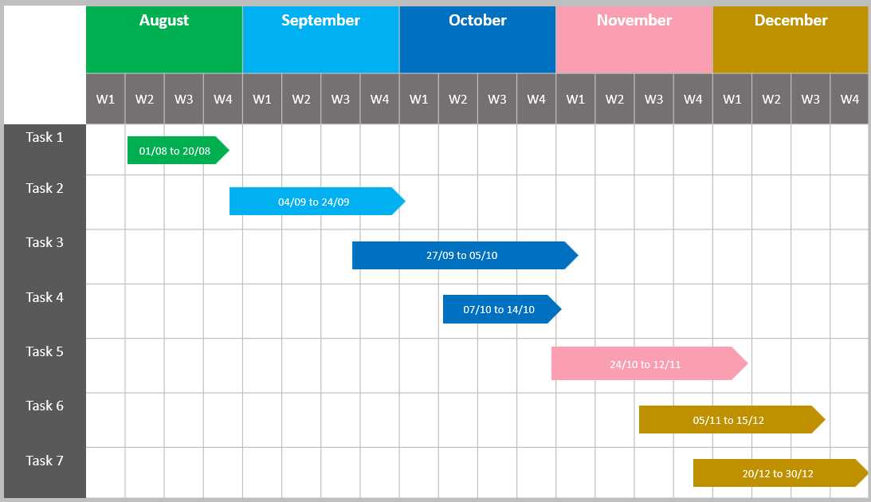
Automotive Electronics Group
School of ECE
Project Planning: Gantt Chart

Slide 30
Automotive Electronics Group
School of ECE
Project Planning:Work Breakdown Structure
Need Statement | Audio Fingerprint | Implementation | Results
Understanding Need statement | Literature Survey on Object tracking | Applying YOLO and Deep Sort | Verification and validation of for object tracking
Converting Need statement to problem statement | Understanding the need of YOLO Deep Sort to track image | Training the model and measure the accuracy | Evaluating the performance measures of model
Survey of given statement | Studying different methods to track the object | Mapping the results | Framing the results

Slide 31
THANK YOU
Automotive Electronics Group
School of ECE

